Slide 1

Problem Solving Session
The remainder of today’s class will comprise the problem solving session (PSS).
Your instructor will divide you into teams of 3 or 4 students.
Each team will work together to solve the following problems over the course of 20-30 minutes.
You may work on paper, a white board, or digitally as determined by your instructor.
You will submit your solution by pushing it to GitHub before the end of class.
Your instructor will go over the solution before the end of class.
If there is any time remaining, you will begin work on your homework assignment.
Class participation is a significant part of your grade (20%). This includes in class activities and the problem solving session.
Your Course Assistants will grade your participation by verifying that you pushed your solutions before the end of the class period each day.

Slide 2
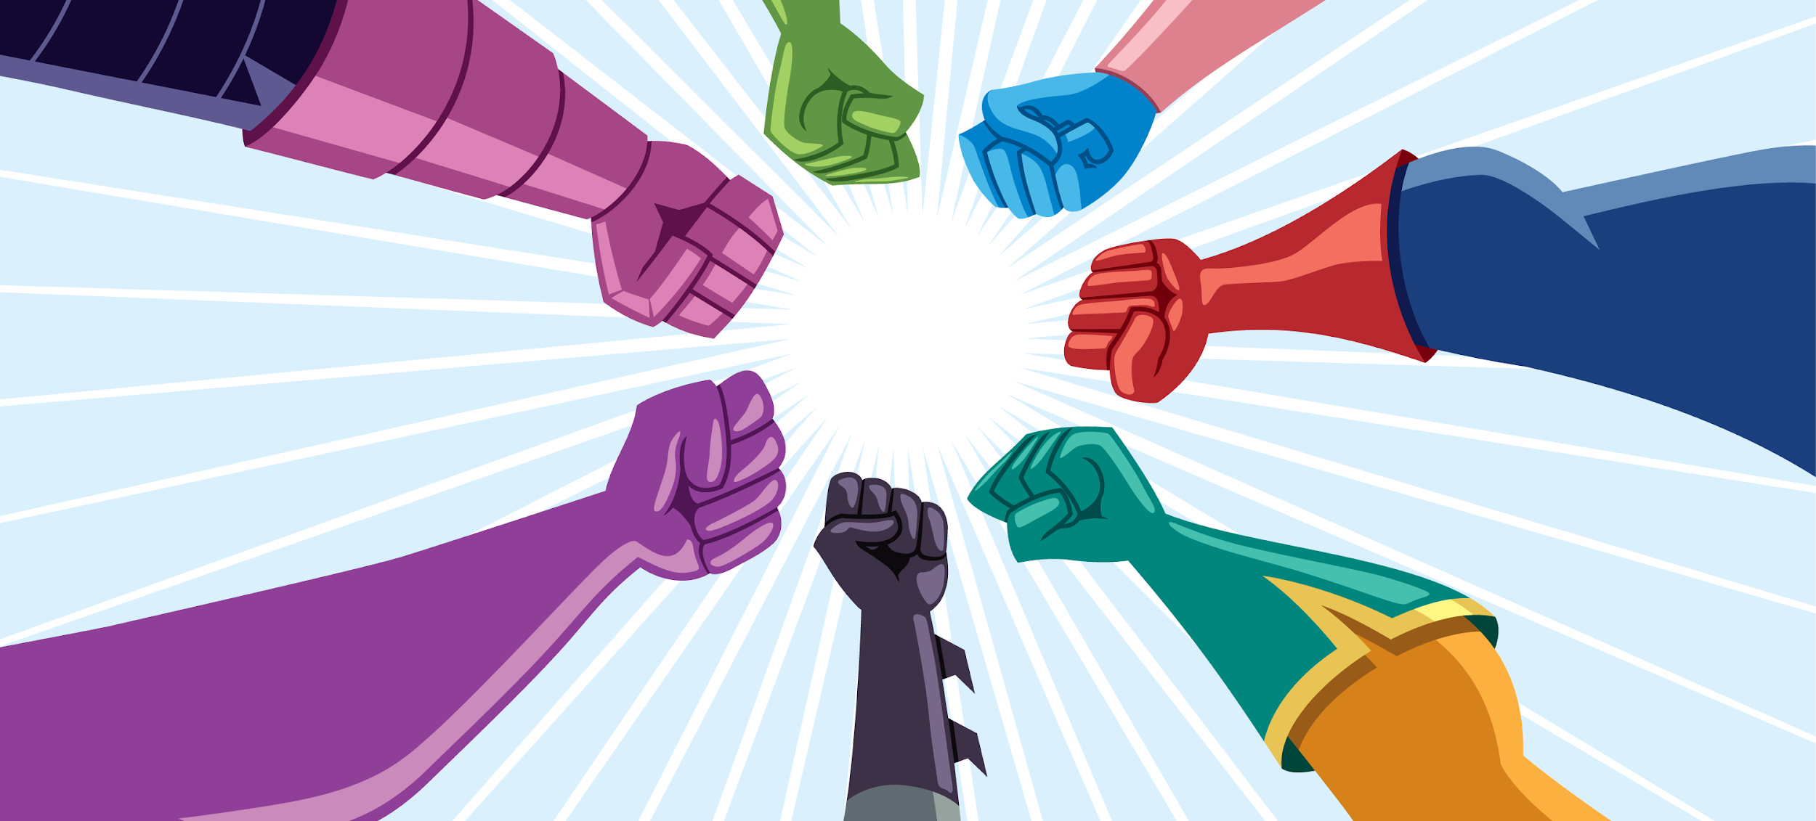
Problem Solving Team Members
Record the name of each of your problem solving team members here.
Do not forget to add every team member’s name! Your instructor (or course assistant) may or may not use this to determine whether or not you participated in the problem solving session.

Slide 3
Problem Solving 1
The first five cards in the deck.
The last five cards in the deck.
The centermost 5 cards in the deck.
The first third of the deck.
Every other card in the deck.
Assume that you have a deck of some number of cards represented as a list of card tuples in the format (rank, suit, name, shorthand), e.g. (2, "Hearts", "2 of Hearts", "H02").
Write the appropriate code to create a slice of the deck to matching each description to the right. Do not assume that the deck has exactly 52 cards in it. You may need to write more than one line of code.

Slide 4
Problem Solving 2
The final outcome of a game of Blackjack is determined by the score of the player and the dealer.
A draw if both bust.
A draw if both scores are equal.
If only one player busts, the other wins.
If neither player busts, the player with the higher score wins.
Write a function that, given the scores of the human player and the dealer, prints a message indicating which of the two won.

Slide 5
Problem Solving 3
When playing Blackjack, every player must choose to hit, which is to draw another card to add to their hand, or stand to stick with only the cards that they already have.
Choosing to stand means that the player can’t get any closer to 21. Choosing to hit risks busting (getting a score that is over 21).
The dealer uses a simple algorithm:
If the human player has busted, stand.
If the dealer has a score under 17 or the dealer’s score is less than the player’s, hit.
If the dealer has a score greater than or equal to 17, stay.
Write a function that, given the player’s current score and the dealer’s current score, return True if the dealer hits and False if the dealer stands.

Slide 6
Problem Solving 4
The goal of a game of Blackjack is to get a score as close to 21 as possible without going over. A score higher than 21 is a “bust,” which is an automatic loss.
The score for a hand of cards in Blackjack is based on the following:
Cards with a numeric rank (2-10) are worth the same number of points as the rank.
Face cards (Jack, Queen, King) are all worth 10 points.
Aces are worth 11 points or 1 point. This depends on whether or not an 11-point-Ace would cause the hand to “bust.”
Write an algorithm that, given a hand of cards, computes the correct score. Assume that the hand will never have more than one Ace (for now).

